Slide 1

An Economic Simulation Analysis of NCAA Football Relegation
By: Connor Lynch

Slide 2
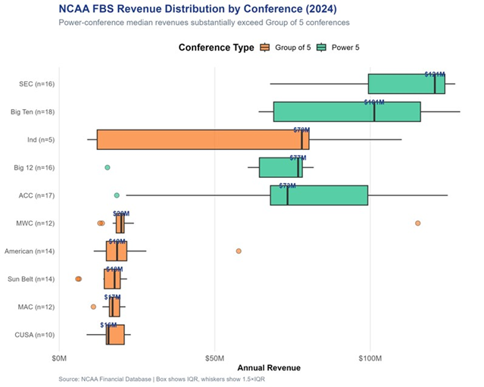
The Current System Leaves 88% of Programs Without Meaningful Stakes
134 FBS programs generate ~$6B annually but revenue is heavily concentrated at the top
The 12-team playoff creates high stakes for fewer than 12% of programs each season
European relegation creates meaningful financial consequences at every level
Would a three-tier relegation structure generate more total revenue?

Slide 3
Three Models, One Question
Monte Carlo: models system-level revenue under five scenarios, answers the policy question
Linear Regression: identifies which features drive team revenue, answers the interpretability question
Random Forest: maximizes predictive accuracy on unseen data, answers the validation question

Slide 4
A Decade of Data Across 134 Programs and Five European Leagues
NCAA Sources: USA Today, Knight Newhouse, College Football Reference, 247Sports, individual athletic department pages
Key variables: total revenue, expenses, media rights, ticket sales, attendance, stadium capacity, donations, NIL spending, revenue rank
European Data: UEFA club reports across England, Germany, Spain, France, and Italy — three tiers per country, 2015-2023 — used to calibrate tier multipliers
Missing data filled using conference-third positional averaging

Slide 5
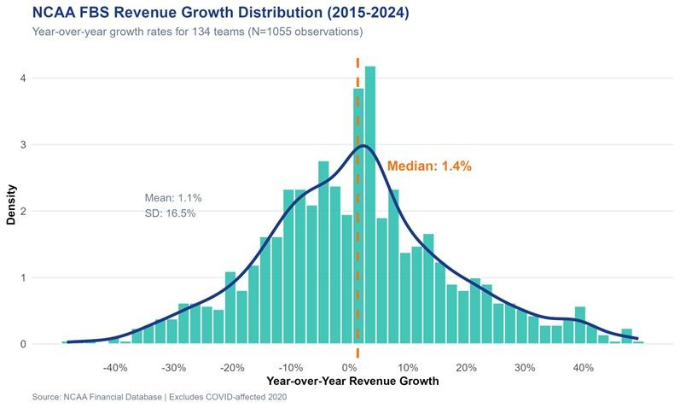
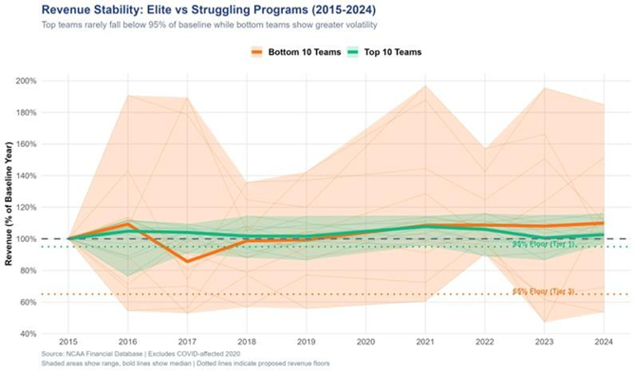
Revenue Is Concentrated and Volatile
Median year-over-year growth is only 1.4% with SD of 16.5%
Bottom programs reach as low as 60% of baseline revenue in bad years
Organic recovery is difficult once a program falls behind
High volatility with low median growth makes the status quo financially precarious for smaller programs

Slide 6
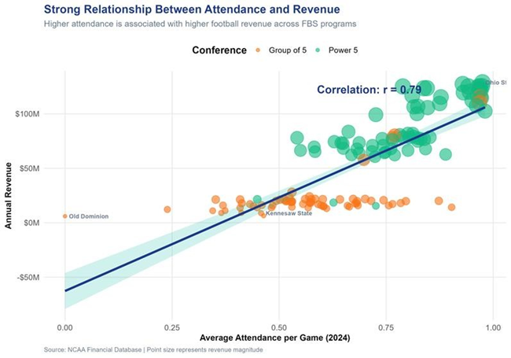
Conference Membership Determines the Revenue Ceiling
Attendance and revenue are strongly correlated (r = 0.79)
Group of 5 programs plateau at low revenue regardless of attendance
Top programs rarely fall below 95% of baseline revenue
Bottom programs reach as low as 60% of baseline, directly calibrating the Tier 3 revenue floor

Slide 7

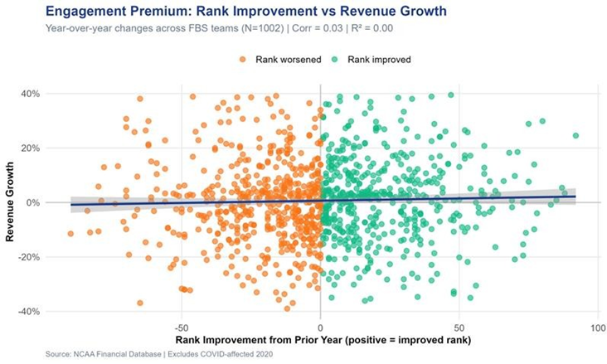
Teams That Improve Their Rank Grow Revenue 9.80% Faster
Measured from 1,002 team-year observations, 2015-2024
Historical finding from the data, not a model prediction
This single parameter drives the entire Monte Carlo relegation scenario

Slide 8
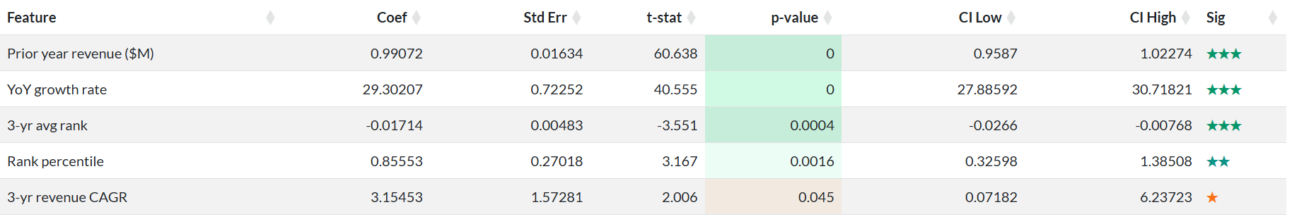
Prior Revenue Dominates All Other Predictors
M5 full model wins on holdout test RMSE: Test R² = 0.996, RMSE = $2.80M
LASSO kept only 3 of 12 features confirming 9 are redundant
F-statistic = 66,410 (p < 0.001), Adjusted R² = 0.9957

Slide 9
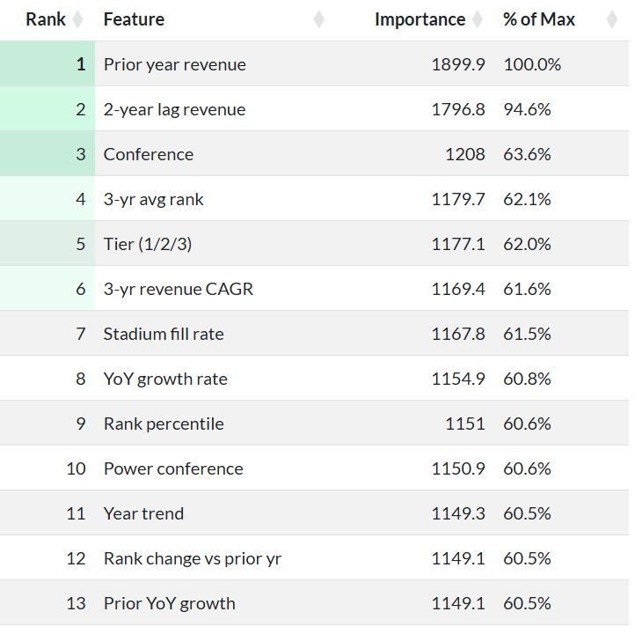
Conference and Tier Determine Long-Run Revenue Trajectory
Optimal RF: 1,200 trees, mtry = 4, min.node.size = 1
Test R² = 0.998, RMSE = $1.91M, MAPE = 2.85%
Tuning improved RMSE 6.6% over default specification
Conference (#3) and Tier (#5) rank above all growth rate features (#8-13)

Slide 10
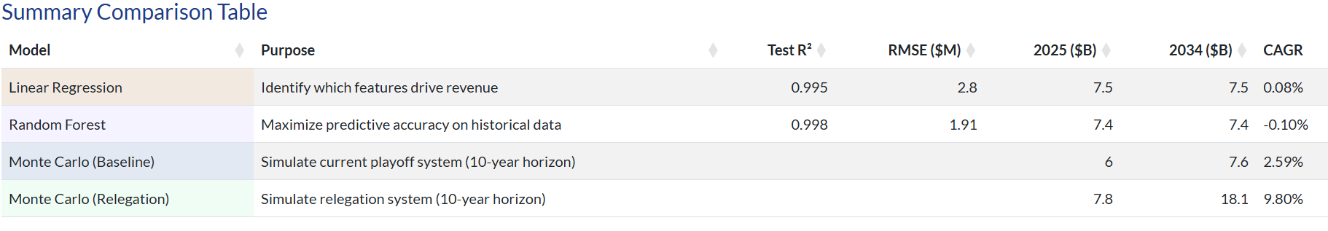
The Status Quo Flatlines
Relegation Changes Everything
LR and RF both project ~0% CAGR confirming no organic growth driver exists
Monte Carlo relegation projects 9.80% CAGR reaching $18.1B by 2034
$10.5B gap driven entirely by expanding meaningful competition from 11.9% to 31.3% of programs

Slide 11
Data-Driven Recommendations
Adopt relegation expands meaningful competition from 11.9% to 31.3% of programs, generating a projected $10.5B premium over 10 years
Implement revenue floors: set at the 5th percentile of historical volatility per tier (65%, 88%, 95%)
Prioritize competitive breadth: 16-team playoff yields identical 2.59% CAGR to the current baseline

Slide 12
Limitations and Next Steps
Limitations:
Engagement premium uses rank improvement as a proxy, not direct fan demand data
European multipliers dampened to 60% without a known NCAA equivalent
ML models capture status quo only, cannot model behavioral responses to relegation
Next Steps:
Incorporate TV ratings, ticket pricing, and merchandise data for a direct causal estimate of the engagement premium
Extend the Monte Carlo to model individual program investment responses to relegation incentives such as increased recruiting spend and facility upgrades
Collect post-2024 data as the expanded 12-team playoff matures to test whether competitive intensity actually increases under the new format

Slide 13
Questions?

Slide 14
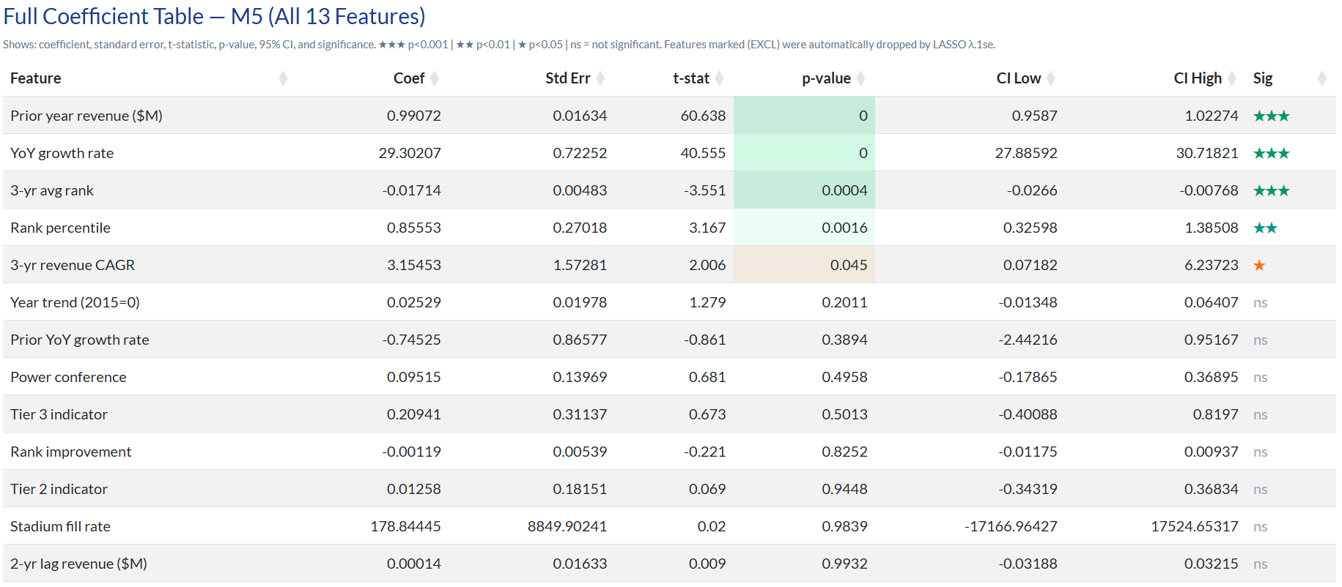
Appendix A - Full LR coefficient table

Slide 15
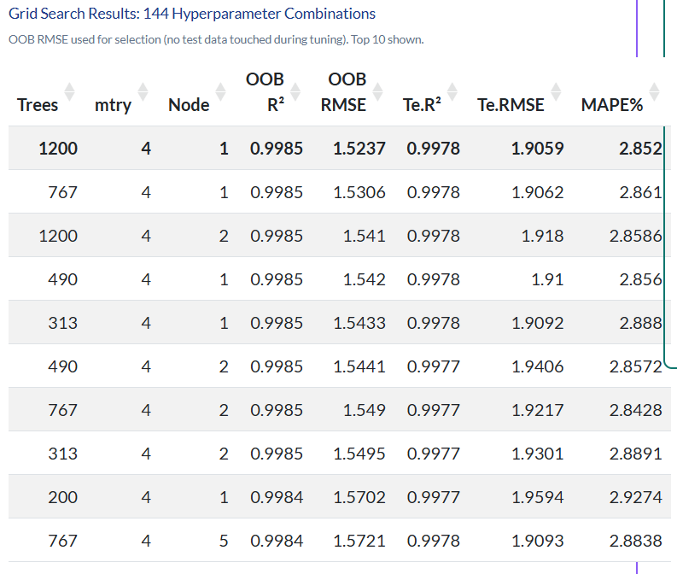
Appendix B — RF grid search top 10 table

Slide 16
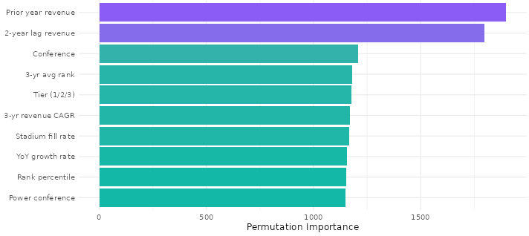
Appendix C — RF full variable importance rankings

Slide 17
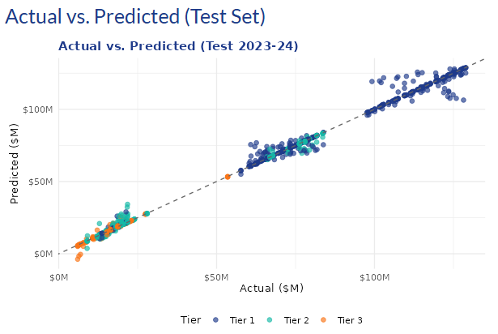
Appendix D — LR actual vs predicted

Slide 18
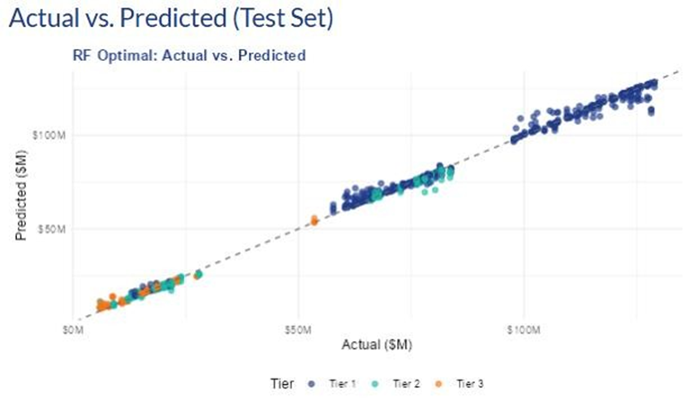
Appendix E — RF actual vs predicted

Slide 19
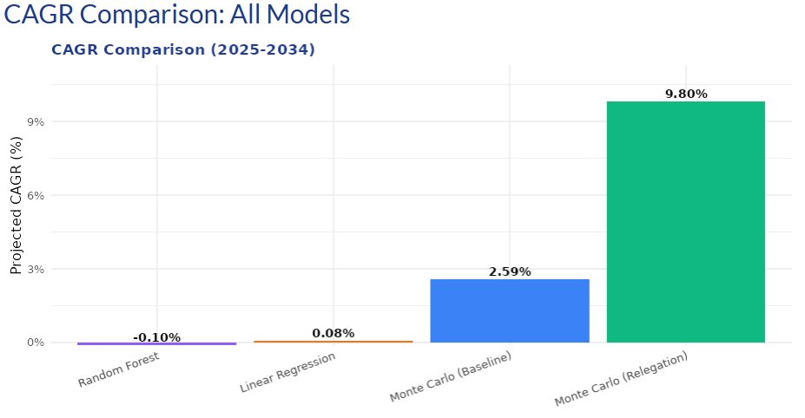
Appendix F — CAGR bar chart across all four models

